Slide 1

DeNovoAutomata
By : Mohammad Alanazi
A platform that
Accelerate drug discovery
A platform that
Accelerate drug discovery

Slide 2

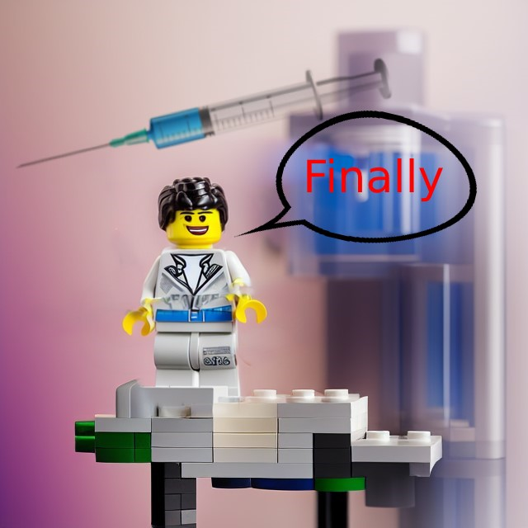



The problem in pharmaceutical
The Problem in the Market
Drug R&D is slow due to wetlab(physical lab)
Pharmaceutical Companies spend a lot of time and money to develop drug candidate that goes under long process through traditional physical labs then often failed for FDA approval
a study show that overall R&D spending is expected to grow by 3% each year, reaching roughly $13.9 USD billion by 2024
How are new medicines developed?

Slide 3


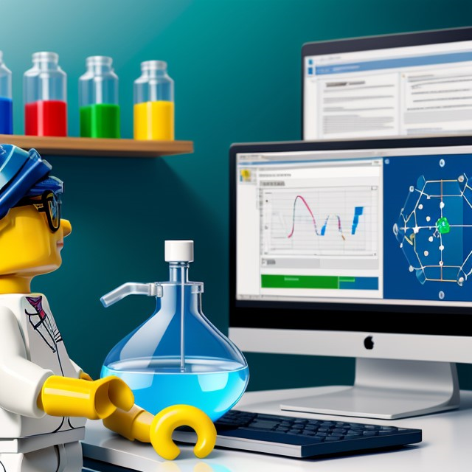



our solution
Drylab automation
(digital lab)
Data is the new oil
Drylab tasks are automatable meaning that it reduce the time needed for a drug to get into the market faster and cheaper
Automated Virtual Screening
Big Data analysis
"Graduates are aware of the basic theory but are not aware of recent advances in technology" Source

Slide 4

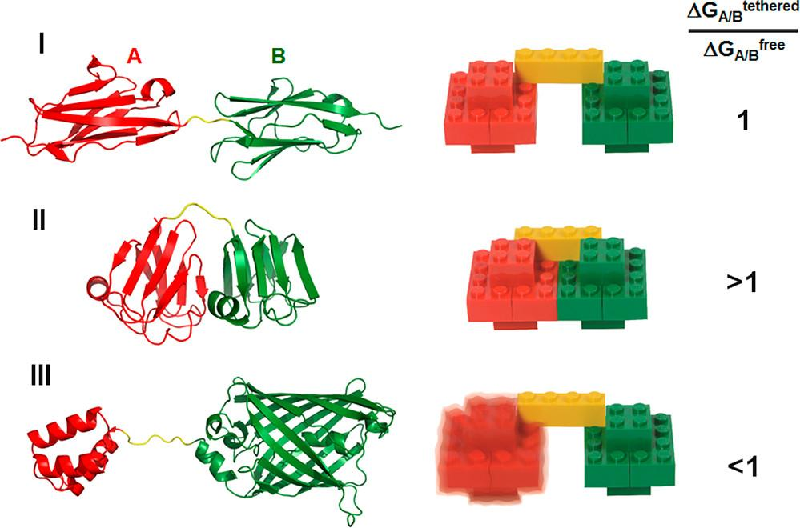
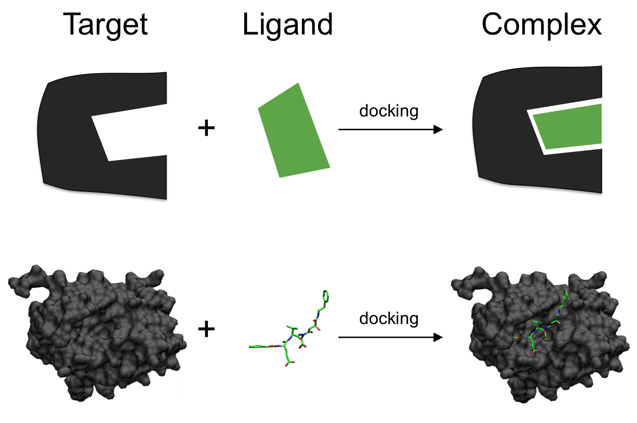
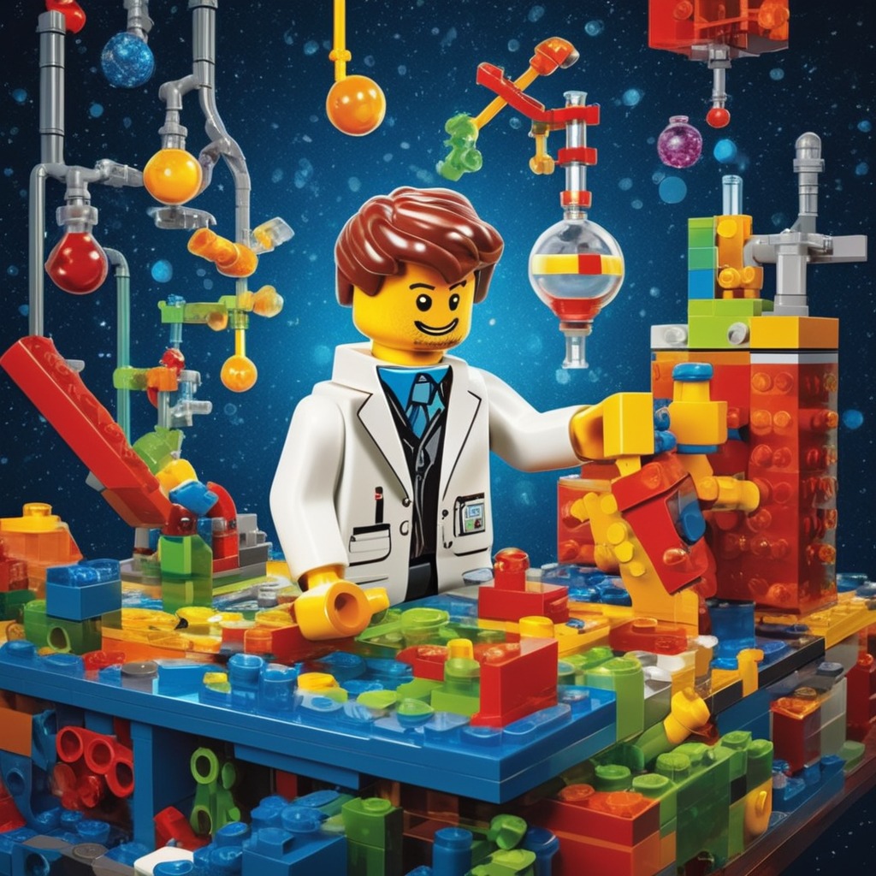





proteins are Lego
Docking
to find drug for any illness a scientist first look at the protein targets that cause the lines.. you can imagine proteins as Lego pieces
through a process called virtual screening,aka Target Fishing
to monitor and list all drug candidate (another Legos ) that have high probability to bind into that protein target
when we find the right Shape- that can fit into the protein brick we theoretically found a new potential drug candidate aka ligand that could translate into medicine

Slide 5
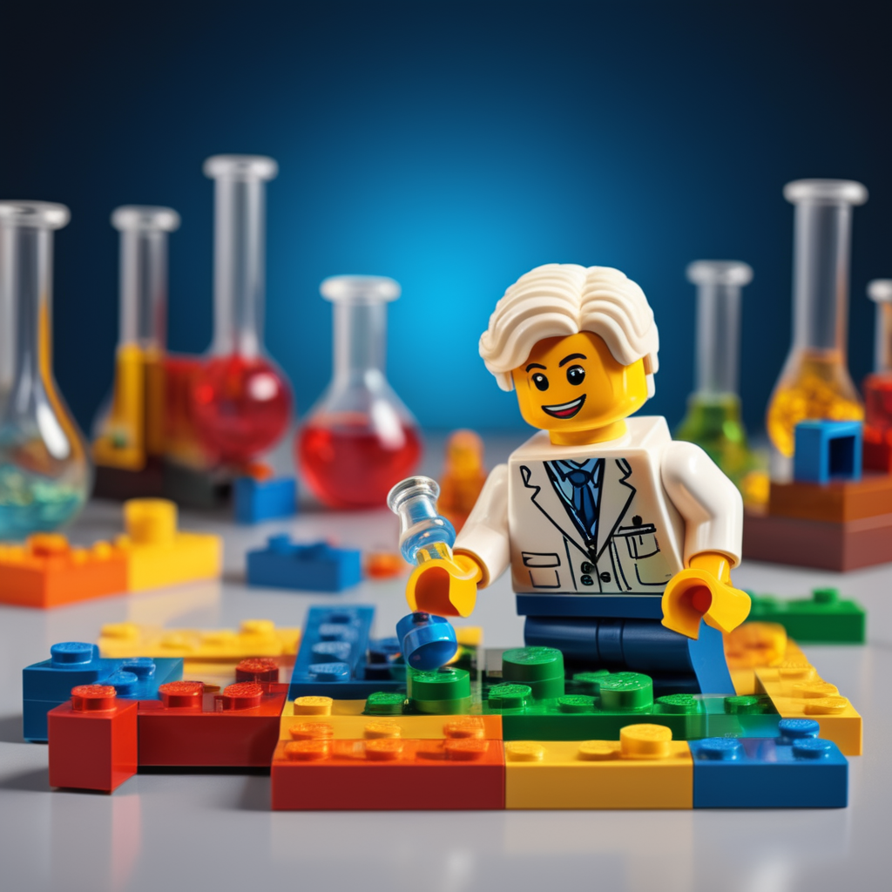


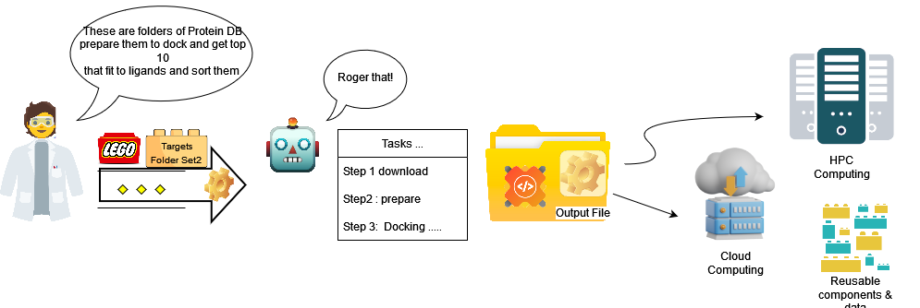
docking & virtual screening (aka target fishing)
are automatable

Slide 6

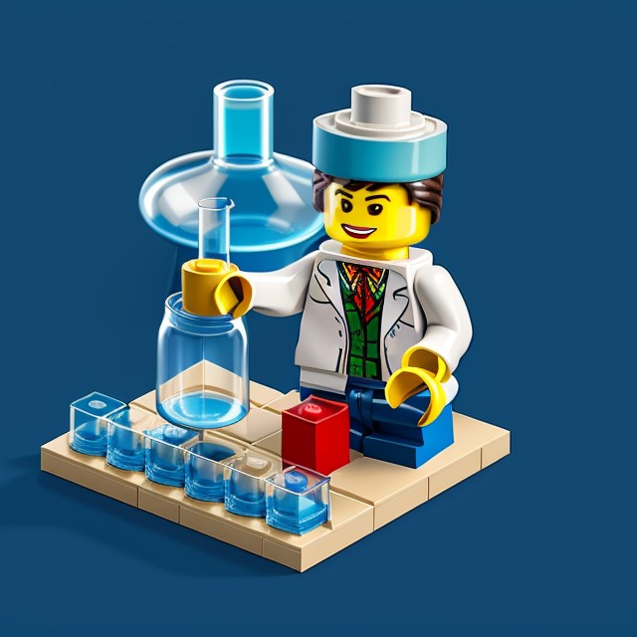
How Your Product or Service is Different
User Benefits
our platform make it easier to automate drylab tasks
e.g find molecules that cure diseases faster and cheaper and scale it to cloud computing eliminate the needs of traditional wetlab techniques and utilizing emergent technologies
using modern 4IR solution utilize automation & HPC and AI making it easier and faster to find molecule and develop drugs that require less time and money thus rapid development that abstract many operation in traditional labs

Slide 7
Market Size <$39.8 USD Billion
$29 USD Billion
a study show that overall R&D spending is expected to grow by 3% each year, reaching roughly $14.203 USD billion by 2024 (Source)
Target Market
$922.58M
TAM :$29 USD Billion (average)
as of 2023 (source)
SAM expected to be around $922.58 USD million (Source)
SOM expected to be around $119 M USD(Source)
<$119.24m

Slide 8
PaaS+ membership model
PaaS model with subscription tier based model, Points(tokens) & Quota (usage )metrics to be flexible & deterministic ACV, ARR is a metric
Enterprise | Plus membership | Entry level
Custom (contact us) -acquisition negotiation | ($49) monthly or ($499) Yearly | ($30) monthly or ($349) Yearly
orchestration serverless Cloud Infrastructure (multi-cloud or hybrid with an on-premise deployments ) | Full Customer support Free Points multi users workspace (collaboration) | documentation and interactive tutorial courses

Slide 9

Projections and Breakeven
3 YEAR PROJECTIONS
 | YEAR 1 | YEAR 2 | YEAR 3
Gross Projected Revenue | 975,000 | 5,000,000 | 11,000,000
Start-Up Costs | 350,000 | 0 | 0
Ongoing Costs | 190,000 | 160,000 | 79,000
Net Revenue | (320,000) | 4,450,000 | 9,500,000
BREAKEVEN
We expect to reach breakeven at month 15 when we reach $770,000. and/or get 2k users
Feature set | Discovery Studio (Direct) | Our | FANG (Cloud providers)
automation | Limited | YES | N/A
flexibility (adjustable pricing) | NA | YES | N/A
HPC | NO | YES | YES
Competitors

Slide 10
Roadmap
well done is better than well said
the best is yet to come
Ideation
Research
PoC
Bootstrapping
VC
Launchpads
incubator & accelerator
Growth
acquisition
Roadmap
Roadmap: Vision and Goals
COMPANY VISION
To be the leading biotech platform adapting new technology that improve people life
COMPANY 3-YEAR GOALS
Create awareness
find brilliant minds (partially done )
innovate on subdomains
(ongoing R&D process)
NEXT STEPS
crowdfunding
develop MVPs
hire expertise
be on frontpage in dedicated journals
POTENTIAL ROADBLOCKS
lack of expertise in subdomains ( as it’s highly academic )
filed to rise money

Slide 11


BIOtech
industrial revolution
Roadmap: Future Opportunities
"for the first time we saw the effective application of AI in biomedicine "
“4ri” first time used in 2016

Slide 12

Summary
so to recap our platform offer autonomous agent based on LLM , you might ask but …why now?
AI is becoming multimodular meaning not only can learn but remember, think and adapt new skills automatically , So Join us to on our journey to collaborate with AI to make the world better , healthier for everyone !

Slide 13
Thank you!
find us @ https://sian.sa/ar/startups/690/prestige-devop

Slide 14


